Slide 1




Bash Commands in Linux
Welcome to the world of Linux command line! Discover the power of Bash commands and become a master of the terminal.
by AEDLA SATHVIKA

Slide 2

Command Line Basics
1
Shell Environment
2
Command Structure
Learn about the shell, environment variables, and customizing your command line experience.
Understand the syntax, flags, and arguments used in executing commands.
3
Navigation Shortcuts
Master useful keyboard shortcuts to navigate faster through directories.

Slide 3
Navigating the Filesystem
1
pwd
Print the current working directory to see where you are in the filesystem.
cd
2
Change directory and move between folders effortlessly.
3
ls
List the contents of a directory, including files and subdirectories.

Slide 4

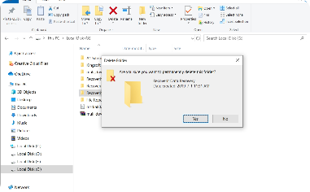
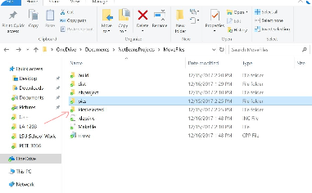
File and Directory Manipulation
cp
rm
mv
Copy files and directories with ease, preserving file attributes.
Delete files and directories, either temporarily or permanently.
Move and rename files and directories.

Slide 5
Text Editing Commands
nano
vim
sed
Edit text files in a simple and beginner-friendly text editor.
Unleash the true power of text editing with the feature-rich Vim editor.
Streamline text manipulation tasks with the "stream editor" command.

Slide 6
Process Management Commands
ps
top
kill
View and manage running processes on your system.
Monitor real-time system resource usage and process activity.
Terminate processes by sending the appropriate signals.

Slide 7
System Information Commands
1
uname
Retrieve detailed system information such as the kernel version.
2
df
Display disk space usage on mounted file systems.
3
free
Show memory and swap space utilization.

Slide 8

Networking Commands
1
ping
2
ifconfig
Check network connectivity and measure round trip times.
Get detailed network interface information and configure network settings.
3
ssh
Securely connect to remote servers using the SSH protocol.

